Slide 1

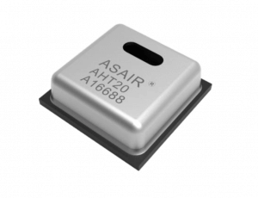
[老葉說技術-第27期] 一次搞懂： 使用Arduino Uno連接高精度溫濕度感測器 (通訊介面為I2C)
AHT20為一具有I2C通訊介面的體積小、精度高、成本低的溫濕度感測器，可以輕鬆取代DHT11/DHT12/DHT22等溫濕度感測器。
具有4根引腳：VCC (接5V或3.3V)、GND (接板上GND) 、SCL (接Arduino UNO板的SCL腳位) 、SDA (接Arduino UNO板的SDA腳位)
AHT20規格介紹：
VCC電壓範圍：2～5.5V
溫度精度： ± 0.3 ℃；濕度精度： ± 2 %RH
Temperature Range: -40 ~ + 85 ℃
Output Signal：I²C
Arduino 需安裝以下函式庫：
Adafruit AHTX0 / Adafruit BusIO
打開第三方範例程式：
範例 → Adafruit AHTX0 → adafruit_aht_test

Slide 2
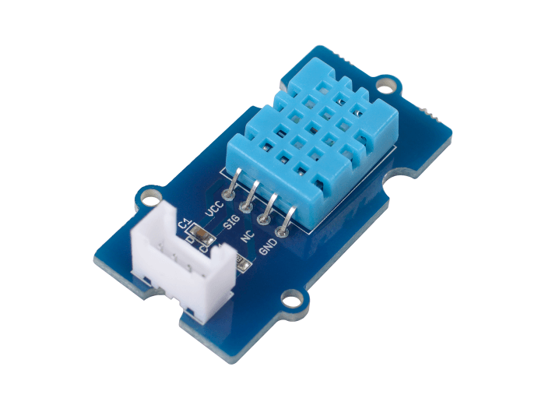
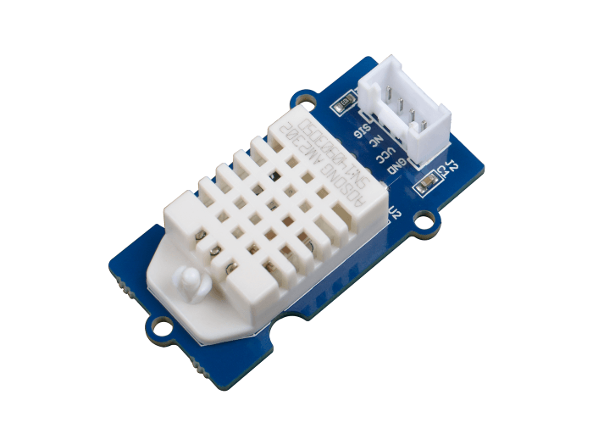
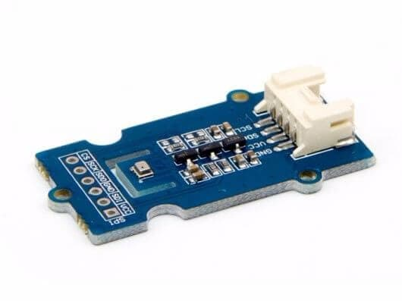
溫濕度感測器比較
引用資料：
https://www.seeedstudio.com/blog/2019/08/22/8-types-of-temperature-sensors-you-should-know/
DHT11
DHT22/AM2302
BMP280
Price | $9.90 / $4.99
Temperature Range | -40 – 80℃
Humidity Range | 0 – 99.9%RH
Size | 40mm x 20mm x 11mm
Humidity/Temperature accuracy | ±2% / ±0.5℃
Price | $8.90
Temperature Range | -40 – 85℃
Air Pressure Range | 300-1100 hPa
Size | 20mm x 40mm
Air Pressure/Temperature accuracy | ±1hPa / ±1℃
Price | $5.90
Humidity Range | 5-95%RH
Dimensions | 40mm x 20mm x 8mm
Humidity/Temperature accuracy | ±5% / ±2℃

Slide 3
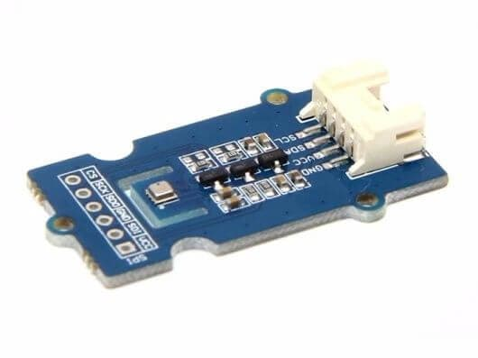

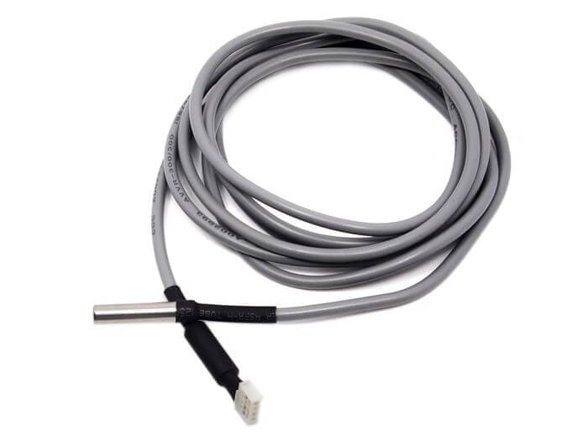
溫濕度感測器比較
引用資料：
https://www.seeedstudio.com/blog/2019/08/22/8-types-of-temperature-sensors-you-should-know/
BME280
DS18B20
AF5485
Price | $17
Temperature Range | -40 – 85℃
Air Pressure Range | 300 – 1100 hPa
Humidity Range | 0 – 100%
Size | 20mm x 40mm
Air Pressure/Temperature/ Humidity accuracy | ±1hPa / ±1℃ / ±3%
Price | $7.50
Temperature Range | -55 – 125℃
Dimensions | 2m
Accuracy | ±0.5℃
Price | $7.50
Price | $49.90
Temperature Range | -40 – 80℃
Humidity Range | 0-99.9%RH
Size | 198.5mm x 15.65mm
Air Pressure/Temperature accuracy | ±0.1%RH / ±0.5℃

Slide 4
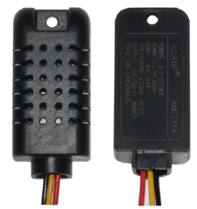
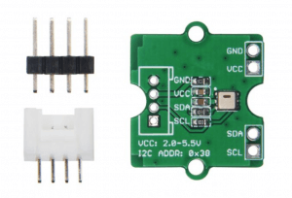
溫濕度感測器比較
引用資料：
https://www.seeedstudio.com/blog/2019/08/22/8-types-of-temperature-sensors-you-should-know/
AM2311A
AHT20
Price | $4.99
Temperature Range | -40 – 80℃
Humidity Range | 0-99.9%RH
Size | 44mm x 20mm x 13mm
Air Pressure/Temperature accuracy | ±3%RH / ±0.5℃
Price | $4.99
Price | $4.90
Temperature Range | -40 – 85℃
Humidity Range | ± 2% RH (25 ℃)
Temperature accuracy | ± 0.3 ℃

